Slide 1


Capstone Project
EDA on Airbnb booking
By
Chetan Prakash

Slide 2
What is Airbnb? And why Analyse it?
Airbnb is an online platform that allows people to rent out their homes or apartments to travelers seeking accommodations. It was launched in 2008 and has since become a popular alternative to traditional hotels and rental properties. The platform allows hosts to list their properties and manage bookings, while travelers can search for and book properties based on their preferences and needs.
We analyse it because analyzing Airbnb data can help us make more informed decisions as travelers. By understanding the factors that contribute to the popularity and success of listings, we can choose accommodations that best meet our needs and preferences.

Slide 3
Problem Statement :-
For this project, we are analyzing Airbnb’s New York City(NYC) data for 2019. NYC is not only the most famous city in the world but also a top global destination for visitors drawn to its museums, entertainment, restaurants, and commerce.
Our main objective is to find out the key metrics that influence the listing of properties on the platform. For this, we will explore and visualize the dataset from Airbnb in NYC using basic exploratory data analysis (EDA) techniques.
Data analysis on thousands of listings provided through Airbnb is a crucial factor for the company.
We will be finding out the distribution of every Airbnb listing based on their location, including their price range, room type, listing name, and other related factors.

Slide 4
Data specification :-
There are total 48895 rows and 16 columns.
List of Columns :-
Id - Guest Unique ID
Name - Guest Name
Host_id - Unique Host Id
Host_name - Hotel name
Neighbourhood_group - Large area
Neighbourhood - Small region or Locality
Latitude - location in degrees
Longitude - Location in degrees
Room_type - Entire home, private room etc
Price - Charges for booking
Minimum_neights - Guest should stay or pay
Number_of_reviews - total number of reviews
Last_review - Last guest review
Reviews_per_month - total number of reviews in a month
Calculated_host_listing_count - How many time guest list it. It shows the expertise and experience.
Availability_365 - Which host is available for year

Slide 5
Agenda :-
We try to answer following questions for Airbnb:
How many hotels are available for 365 days and top 5 hosts' names?
Is the Manhattan neighborhood preferred over other neighborhoods?
For each neighborhood count how many of them prefer the same location?
Best rating hosts according to their price?
Minimum nights people should pay per host?
Busiest hosts and why?

Slide 6
Agenda :-
Distribution of listing across the neighborhood?
Grouping neighborhoods according to their location with pricing?
Most demanding Host for Airbnb?
Which area get the highest number of reviews?
Correlation between all the data?

Slide 7

Map of New York City :-

Slide 8
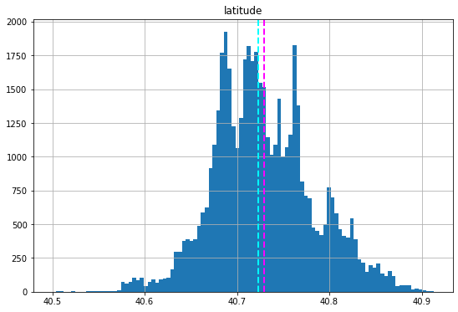
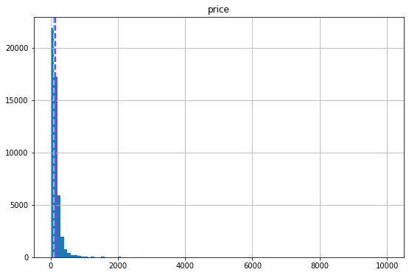
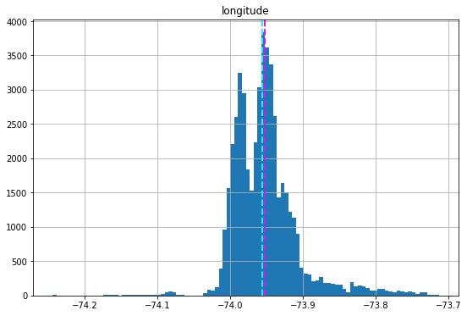
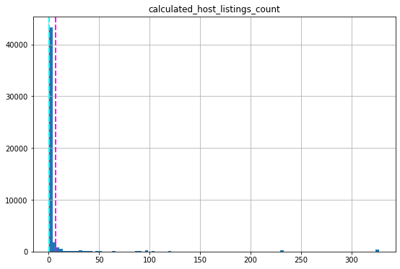
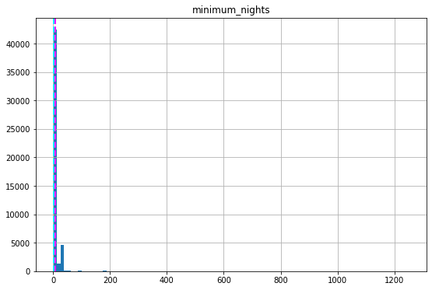
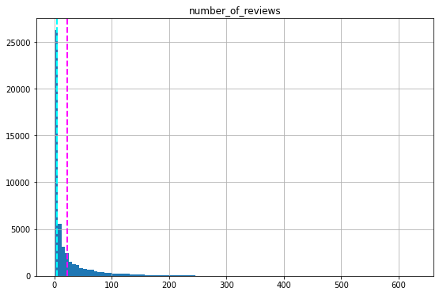
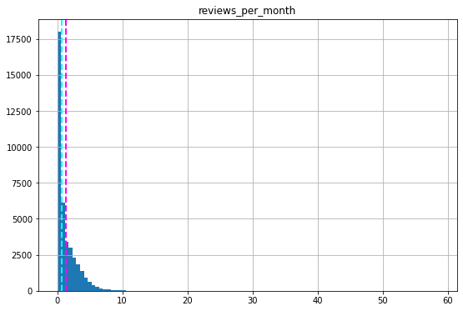
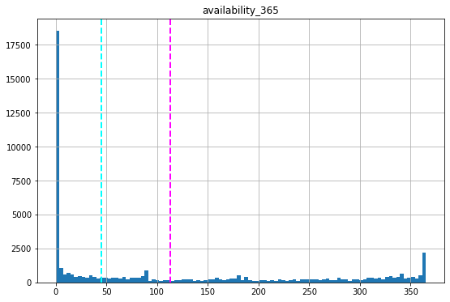
Mean and median value of all the numerical value

Slide 9
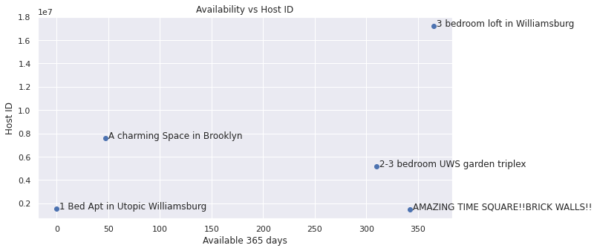
How many hotels available for 365 days :-
As we see according to our dataset and our analysis that most of the people preferred an Entire home/apartment(25409) compare to a private room(22326) or shared room(1160).
And as we talk about availability 365 days total number of locations available is 1294.

Slide 10
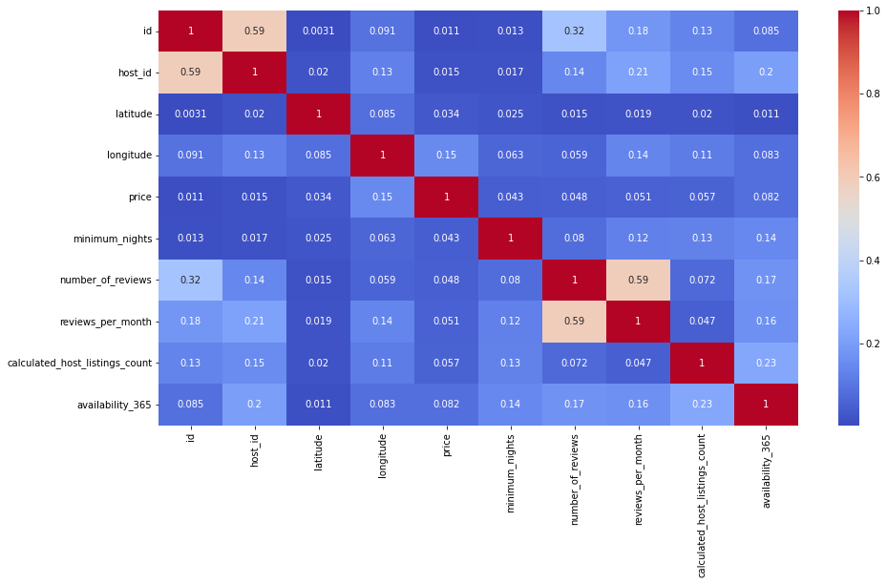
Correlation between all the numerical data
As we can see from this chart that there is not that much correlation between the given category because the maximum value here we found is 0.32 between Host_id and number_of_reviews and some more correlation between host_listing_count to availability_365.

Slide 11
Is the Manhattan neighbourhood preferred over other neighbourhood :-
As we can see through our analysis that people prefer Manhattan neighborhood locations compared to other locations.
Manhattan 21661
Brooklyn 20104
Queens 5666
Bronx 1091
Staten Island 373

Slide 12
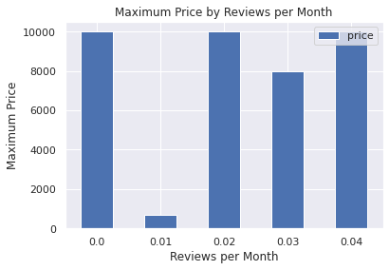
Best rating hotel according to their price :-
As we can see from this analysis generally people review that hotel who have less prices.
From the 1st bar, the price is around 1000 whose reviews are 0 and at the 3rd bar, the price is again around 1000 rupees whose reviews are 0.02.

Slide 13
For each neighbourhood count how many of them prefer the same location :-
Index | host_name | neighbourhood_group | calculated_host_listing_count
13217 | Sonder(NYC) | Manhattan | 327
1834 | Blueground | Manhattan | 232
1833 | Blueground | Brooklyn | 232
7275 | Kara | Manhattan | 121
7480 | Kazuya | Queens | 103

Slide 14
Minimum nights people should pay per location acc to the price :-
Index | Minimum_nights | Name | Price
0 | 100 | Furnished room in Astoria apartment | 327
1 | 30 | 1-BR Lincoln Center | 232
2 | 5 | Luxury 1 bedroom apt. -stunning Manhattan views | 232
3 | 99 | Quiet, Clean, Lit @ LES & Chinatown | 121
4 | 30 | 2br - The Heart of NYC: Manhattan's Lower East Side | 103

Slide 15
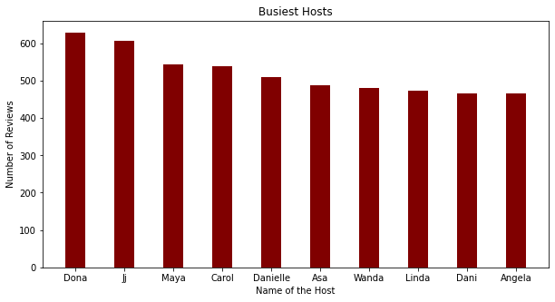
Most busiest location and why :-
As we can see that Dona, Jj, Maya, Carol, and Danielle is the top 5 busiest host.
According to the chart, the highest number of reviews is the maximum number of people who choose them.
So we try to make each and every review should be good so that helps in our business.

Slide 16
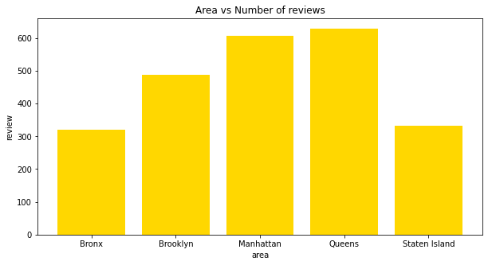
Area have highest number of reviews :-
As we see the highest number of reviews gets the Queens area which is 629.
So if the number of reviews is the highest people visit them most.
In these top 10 Angela is the lowest one so we have to improve it.

Slide 17
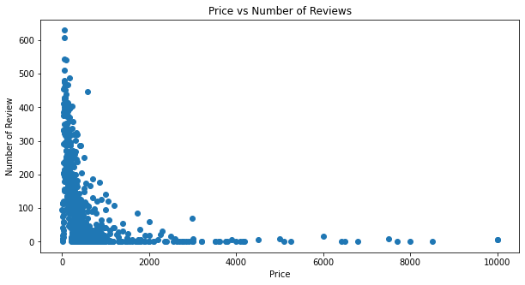
Price of host according to their number of reviews :-
So we have already seen that generally, the price is low where people review and here people's highest reviews mean generally the price is less in Queens locations.

Slide 18
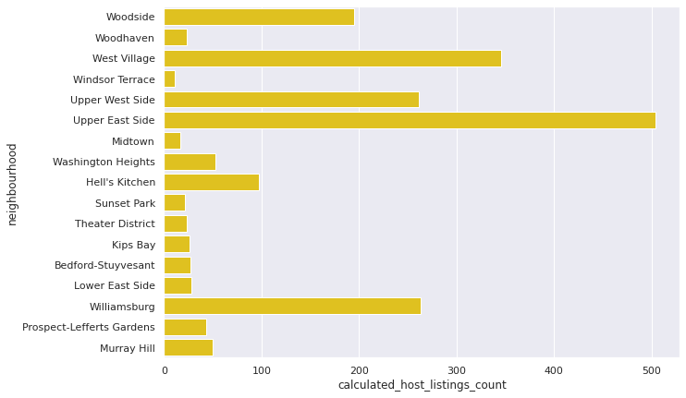
Distribution of listings across the neighbourhood :-
With this chart, we can say that most of the listings are located in Upper East Side.
So we have to check why Upper East Side is most listed and why others are not and make changes according to it.

Slide 19
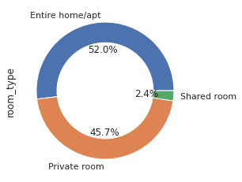
Room type distribution :-
We already know that most people choose an Entire home/apt and according to it, the availability of room type is seen.

Slide 20
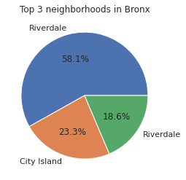
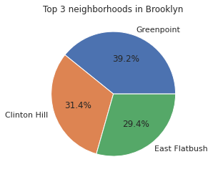
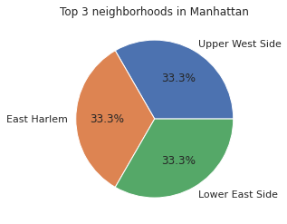
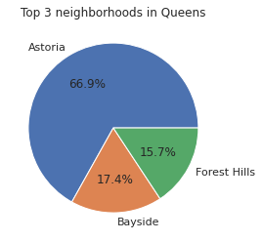
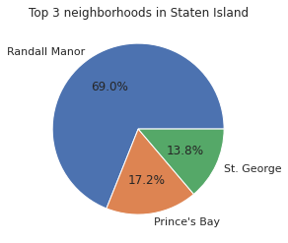
Grouping neighbour according to location :-
Grouping neighbors according to top location shows which area has the top 3 hosts so according to it we can make changes to other hosts.

Slide 21
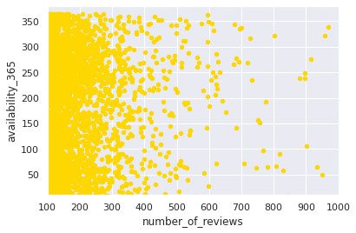
Most demanding host for Airbnb :-
The most demanding host is Gurpreet Singh whose number of reviews is the highest which is 1157, Michael with a number of reviews of 732, Deloris with 693, and so on.
So these are the popular or premium hosts.

Slide 22
Challenges Faced :-
Reading the dataset and understand the meaning of some columns.
For answering some of the question we had to understand the business model of airbnb.
Handling the null values.
Design multiple visualization to summarize the information into the dataset and successfully communicate the result and trends to the reader.

Slide 23
Points which help Airbnb into their business :-
Manhattan is the most focused place in NYC for host do their business.
Customer pay highest amount in Brooklyn, Queens and Manhattan (i.e. $10000 -$10).
For the three types of room(Entire home/apt, private room and shared room) avg price is highest for Entire home/apt is 211.79, Private room is 89.78 and sharing room is 70.12.
There are total 1294 location who available for 365 days this information help to find people location where they can go anytime.
Then we see how best rating hotels according to their price this will help in business in improvement point of view that how we can improve so our rating, reviews, listing count will increase.

Slide 24
Some more points :-
And we see mostly people review those host who have less price so those host who don’t get enough reviews because may their price is too high make them less.
Upper East Side part having maximum number of list count
People choose Entire home/apt generally like so we have 52% of it, Private room 45.7% and Shared room 2.4 % so we have give more focus on Entire home/apt option so our profit will increase.
And we have to appreciate our premium customers like Gurpreet Singh
And we also check from group pie chart that which host doing well in a particular location.

Slide 25
Thank You

